Slide 1
With Big data comes big responsibility
John Fritz
John.Fritz@amd.com
Twitter: JohnFritz

Slide 2

“With Great Power there must also come Great Responsibility” – Stan Lee
Source: Amazing Fantasy #15, Aug, 1962

Slide 3
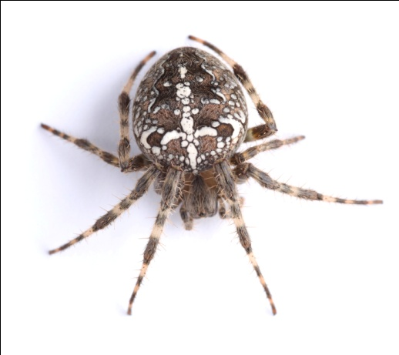


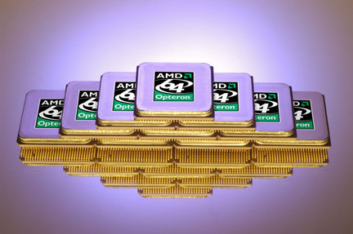
…….
+
+
=
Superpowers!

Slide 4
Goals for this talk
Use your Superpowers for good…and profit!
It ain’t about the web; its how you swing that counts!
Don’t bite the data stream that feeds you!

Slide 5
Kumbaya

Slide 6
The Squirm Factor

Slide 7


Happy Data Scientist
Anxious Data Scientist
Squirm Continuum

Slide 8
“Can you help us find the most
efficient way to route our cargo?”
- airline executive
Squirm Continuum

Slide 9
“How long can we keep trans-fats in our products before we risk a “Tobacco” like law suit?
- Consumer Goods Executive
Squirm Continuum

Slide 10
“Can you help me adjust my weapons
portfolio to maximize my Kills per Million”
- Lt. Col., US Army
Squirm Continuum

Slide 11
“We like to create a monopoly….then
induce volatility”.
- Head Commodity Trader
Squirm Continuum

Slide 12



Slide 13

The “promiscuity” problem

Slide 14

How are you Feeling?
Lucky
Unlucky
Time or Pulls

Slide 15

Don’t play angry!

Slide 16
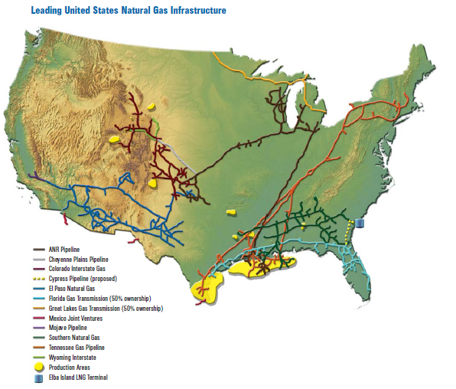
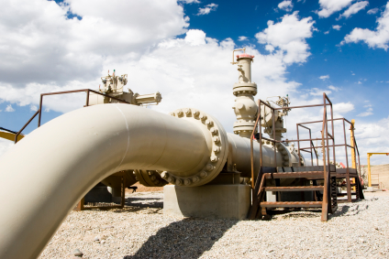

Slide 17
Results
Addressing Promiscuity
Playing Angry
-Higher loyalty
-Higher hold
-#1 Gaming Company
-Shareholder return
-$1.7 Billion fine
-Fired CEO
-Increased scrutiny
-Rich attorneys

Slide 18
The Great Responsibility…..
An ethical framework in 5 minutes or less.

Slide 19

1. Is this an ethical Issue??
Will this happen to somebody as a result of my decision/action?*
*hint: verb, not noun

Slide 20

2. Get the facts, Jack (Webb)
What am I missing?
Who are the stakeholders?
What are my options?

Slide 21
3. Consider Alternative Actions
Which produces most
good and least harm?
Which treats people equally or proportionally?
Which respects the rights of all stakeholders?
Which best serves the whole community?
Which leads me to act as the person I want to be?

Slide 22
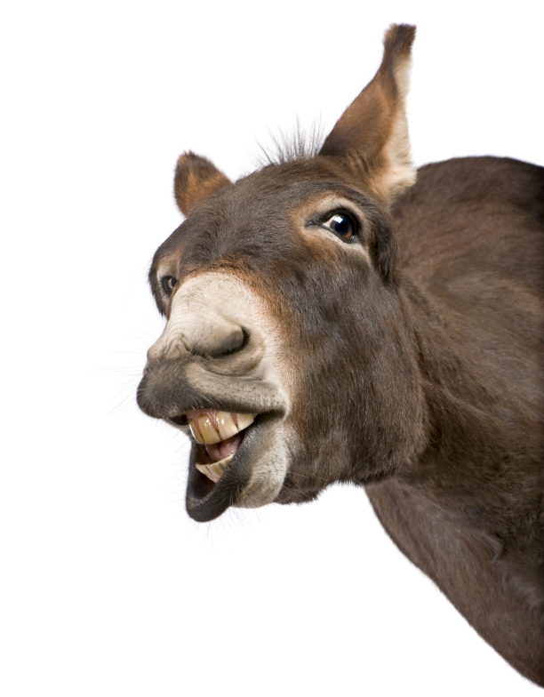
4. Make Decision and Test it
Based on my actions will my
Mom think I am one of these?

Slide 23
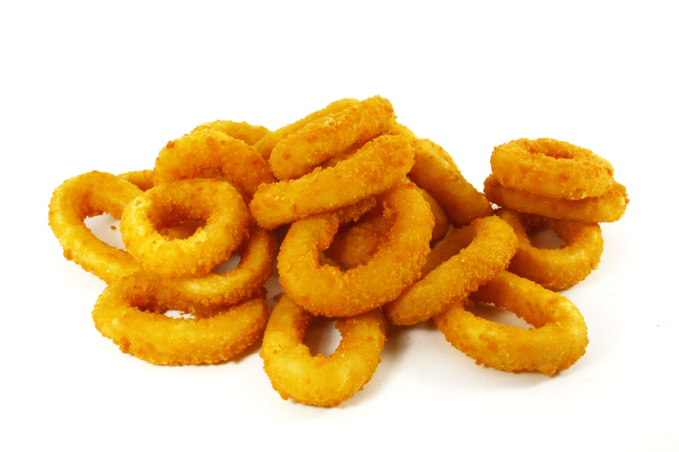
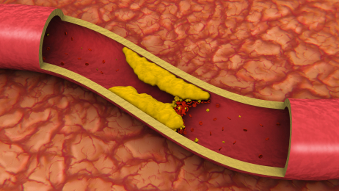
Choices
Consequences

Slide 24
Dilemma
“On a per-calorie basis, trans fats appear to increase the risk of CHD more than any other macronutrient, conferring a substantially increased risk at low levels of consumption”
- New England Journal of Medicine

Slide 25
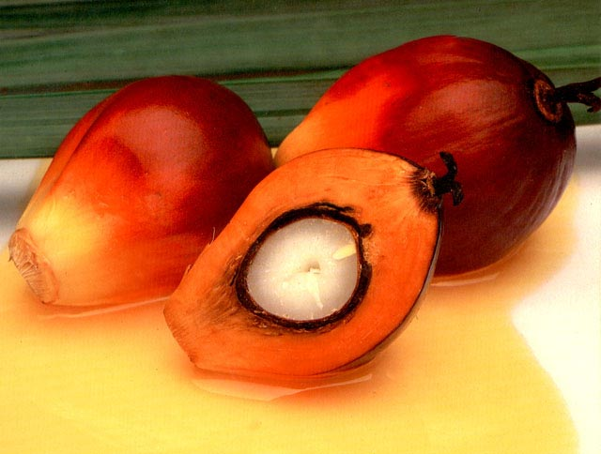
Yum, a natural replacement!

Slide 26
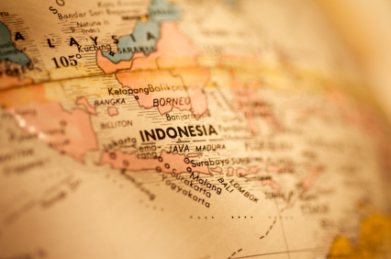
Which grow in developing tropical countries.

Slide 27
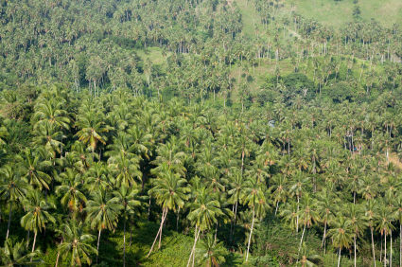
Bringing opportunity for economic growth!

Slide 28
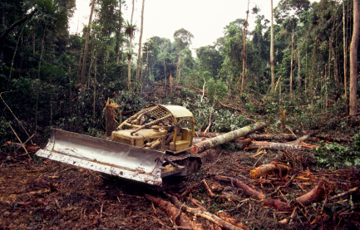
And increased logging revenues…

Slide 29
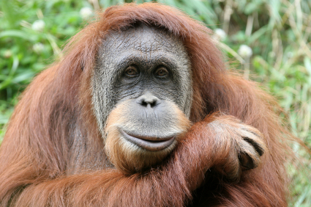
We might have to relocate some of the neighbors…

Slide 30
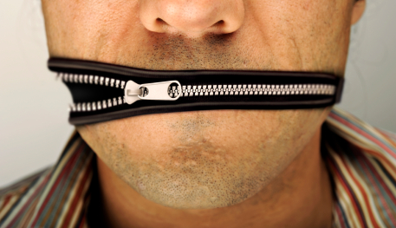
Don’t bite the data stream that feeds you!

Slide 31
Intelligence is not a privilege;
it is a gift to be used for the good of mankind!
-Dr. Otto Octavius, aka Doc Ock

Slide 32

Learn More
http://www.scu.edu/ethics/
Disclosure: AMD is a supporter of the Markkula Center

Slide 33
Diamonds in the Data Mine, Gary Loveman. Harvard Business Review, May 2003.
http://hbr.org/2003/05/diamonds-in-the-data-mine/ar/1
Did the Carlsbad, NM Pipeline Failure Contribute to California’s 2001-2002 Energy Crisis?
Biot Report #559. Suburban Energy Management Project. November, 2008
http://www.semp.us/publications/biot_reader.php?BiotID=559
Judge says Supplier Inflated Gas Prices in California Crisis. Richard Oppel and Lowell Bergman,
New York Times, Sept. 24, 2002
How to Make an Ethical Decision. Markkula Center for Applied Ethics.
http://www.scu.edu/ethics/practicing/decision/making.pdf
Trademark Attribution
AMD, the AMD Arrow logo and combinations thereof are trademarks of Advanced Micro Devices, Inc. in the United States and/or other jurisdictions. Other names used in this presentation are for identification purposes only and may be trademarks of their respective owners.
©2011 Advanced Micro Devices, Inc. All rights reserved.

